Slide 1
legend
by
site
and
species
(hopefully
manageable)
∆AGB (Mg)
∆r (mm)

Slide 2
(b)
(d)
(a)
(c)

Slide 3
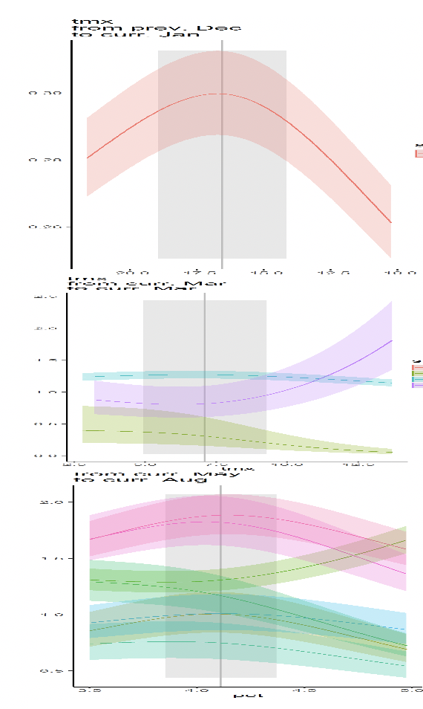
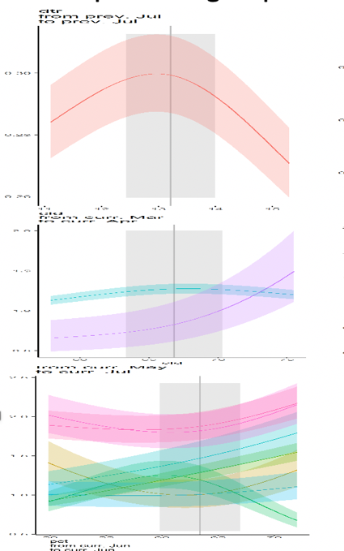
Precipitation group
Temperature group
T range group
Species legend
Site (ordered by latitude)

